Slide 1
Aspect based Topic Modelling analysis on Yelp Restaurant Reviews
Identifying Business Improvement opportunities for restaurants using Machine learning in Python

Slide 2
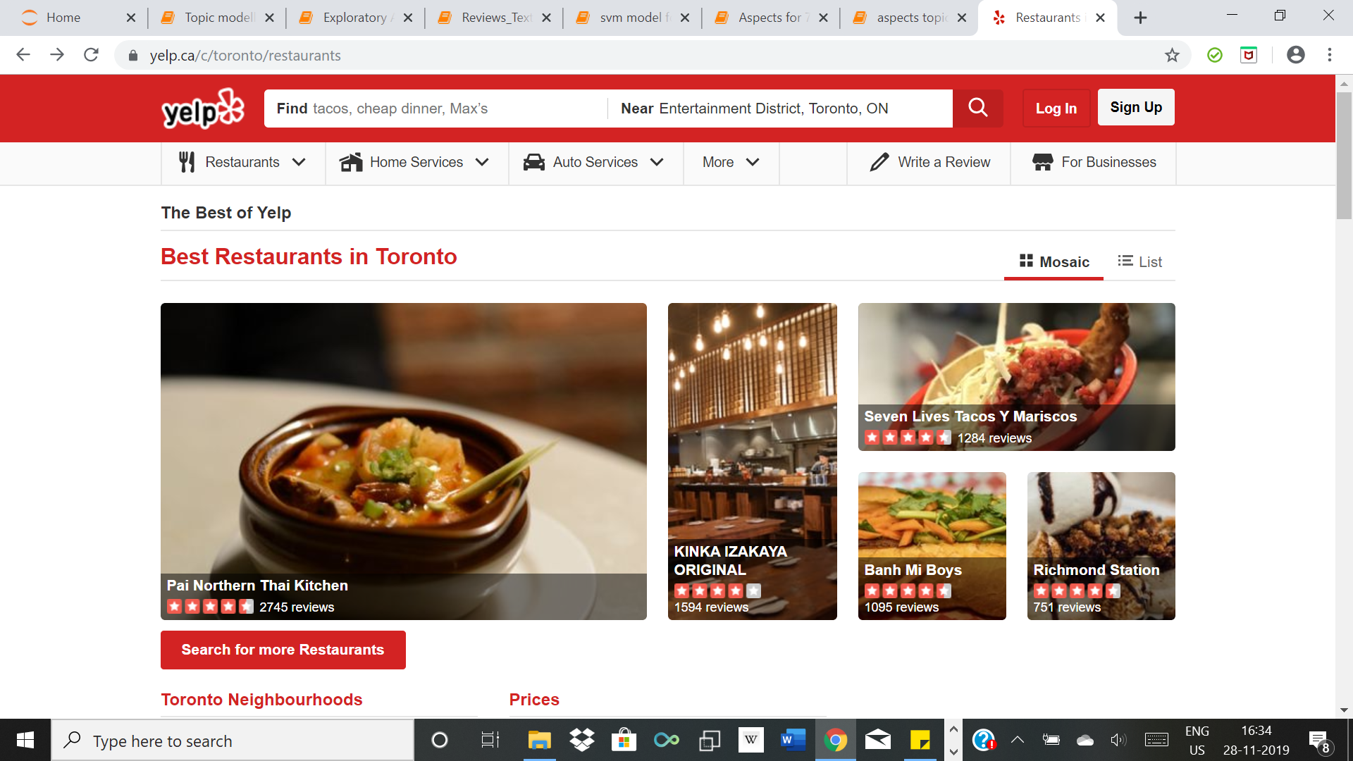
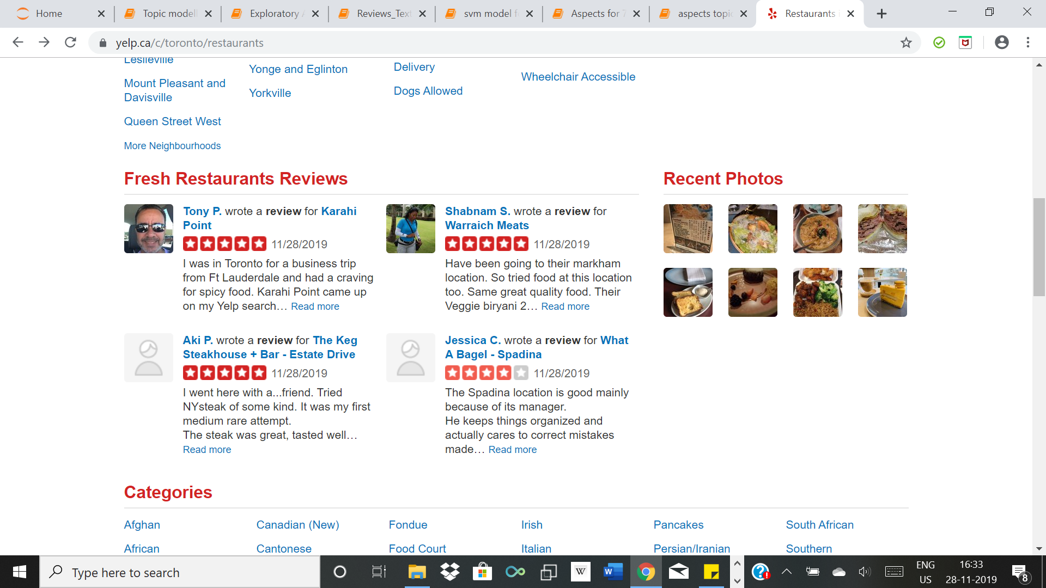
Introduction X Background

Slide 3
Introduction X Inspiration
Example Review:
“We were hoping for a quick breakfast. We were immediately seated, which was probably the highlight of our meal. It took about 15 min to get a coffee and another 15 min before anyone came to ask for our order. When our food finally came, nearly all of our food was undercooked; half cooked eggs, partially cooked ham and black bacon, overcooked bacon.”

Slide 4
Introduction X Objective
Identify sentiments of people for restaurants through performing topic modelling analysis on the reviews
Extract positive and negative sentiments of restaurant businesses by segregating them according to various aspects of the restaurants. (like ambience, quality of service etc.)
Notes:
State that we converted all the files from json to csv

Slide 5
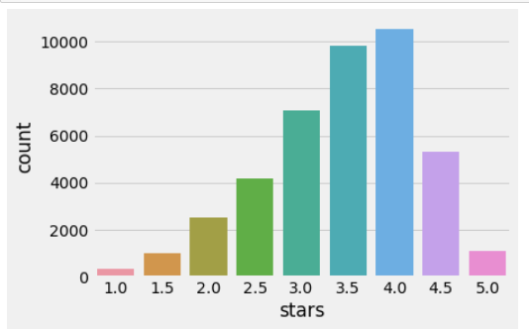
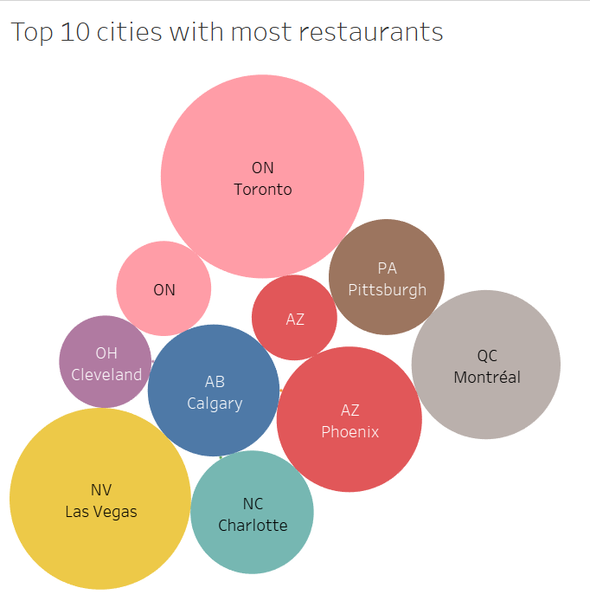
Exploratory Analysis

Slide 6
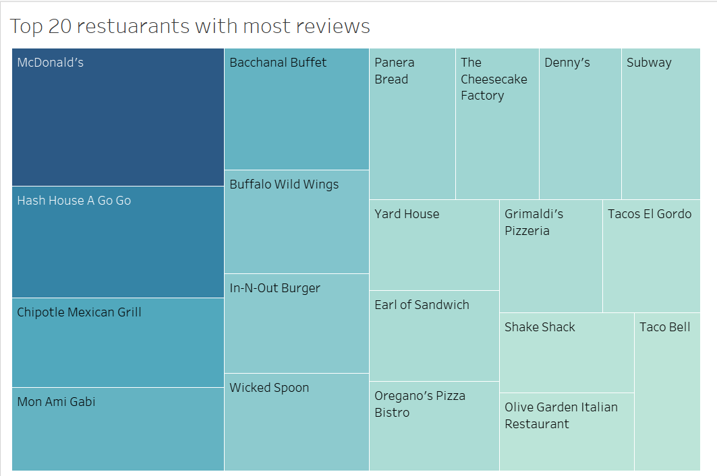
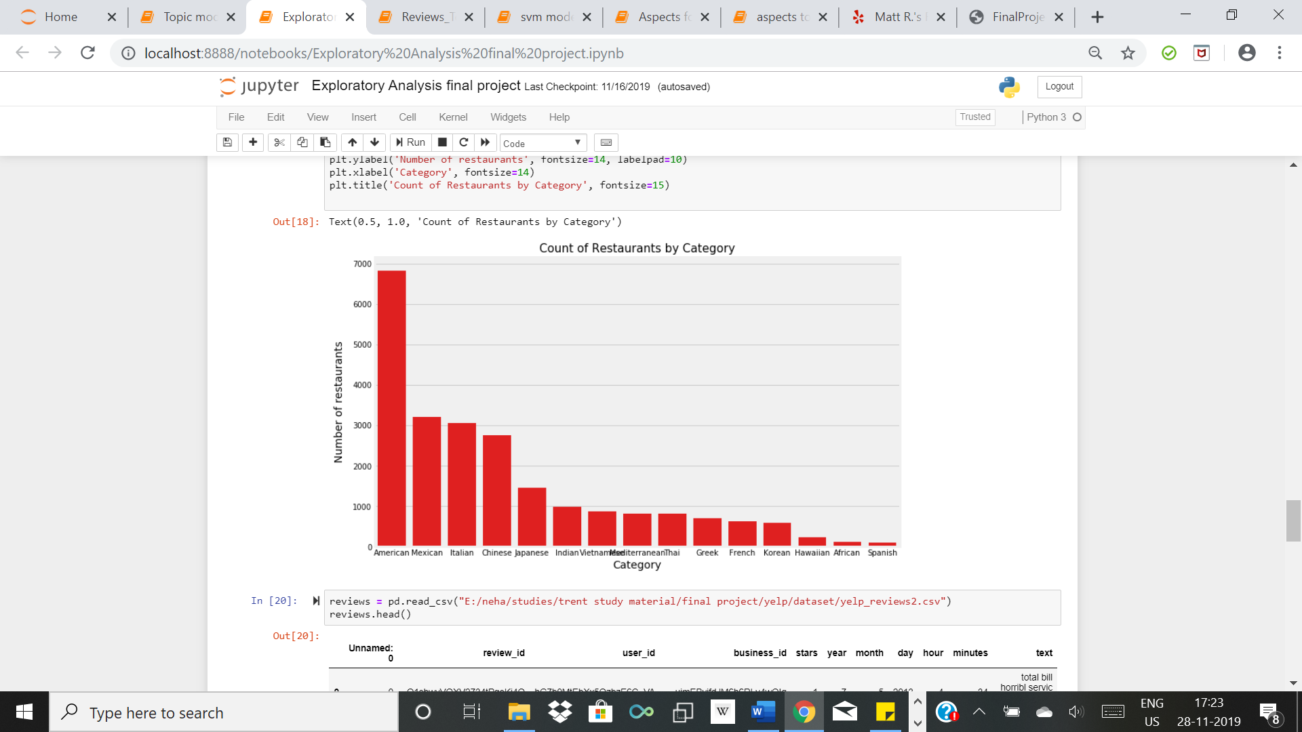
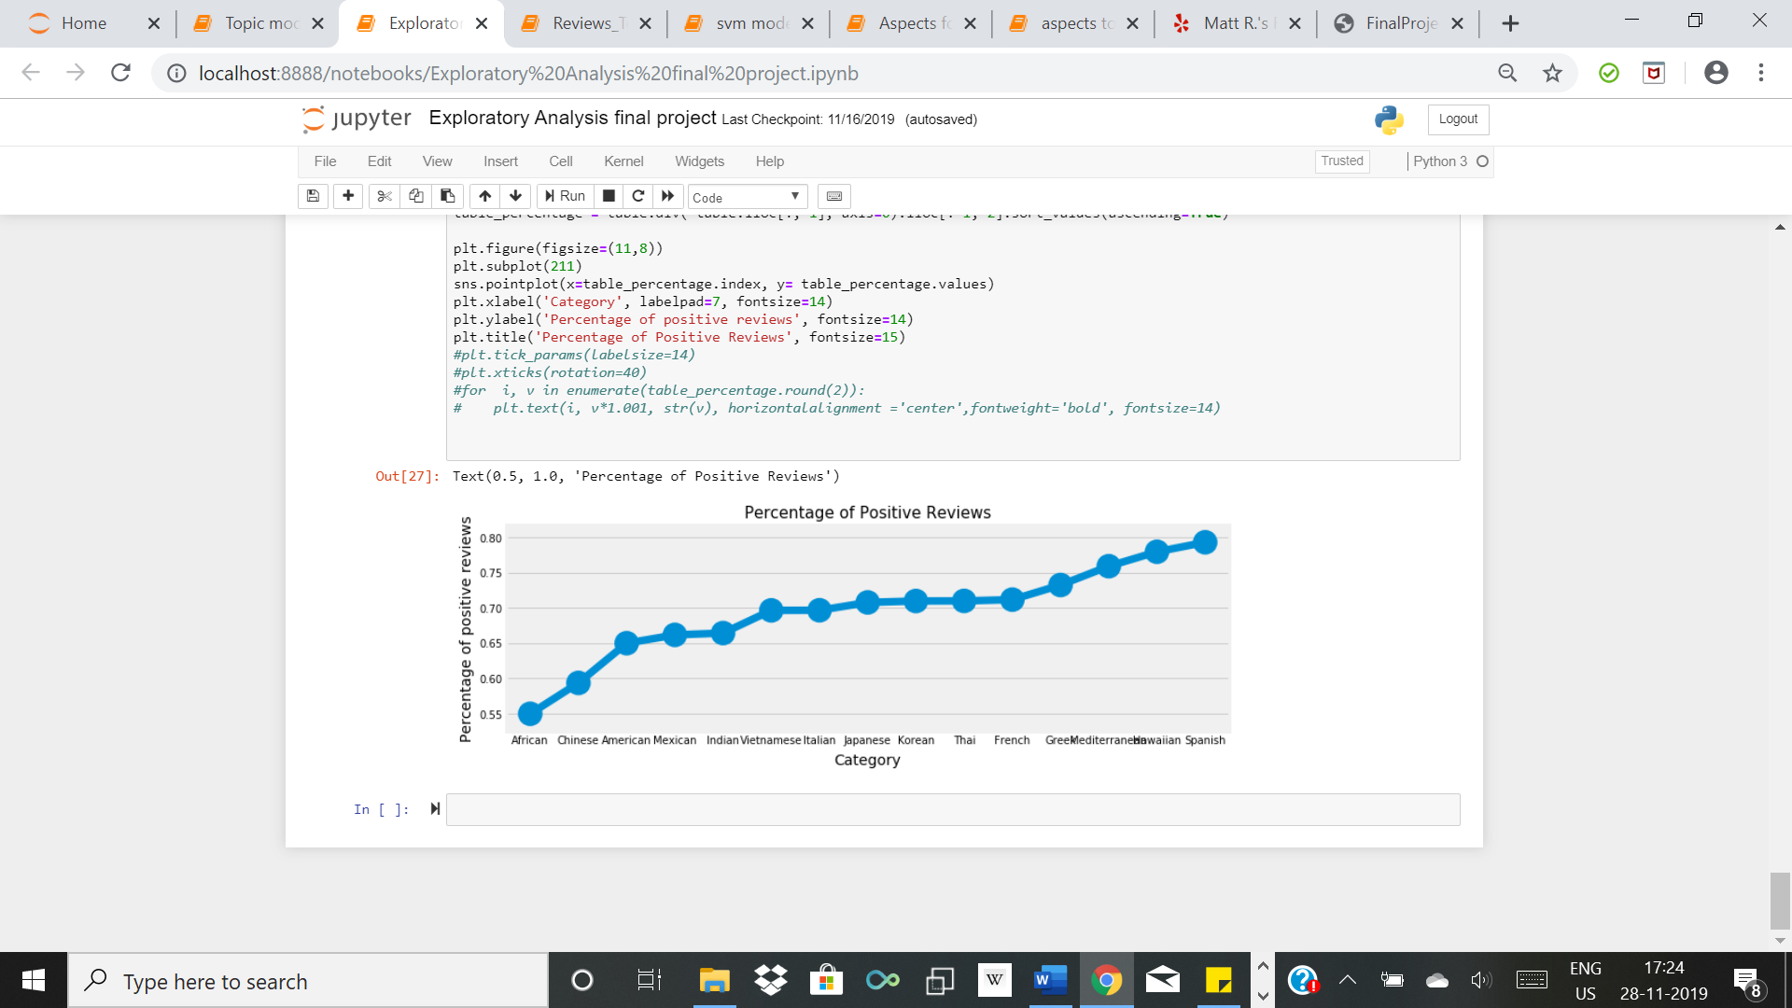
Exploratory Analysis (continued)

Slide 7
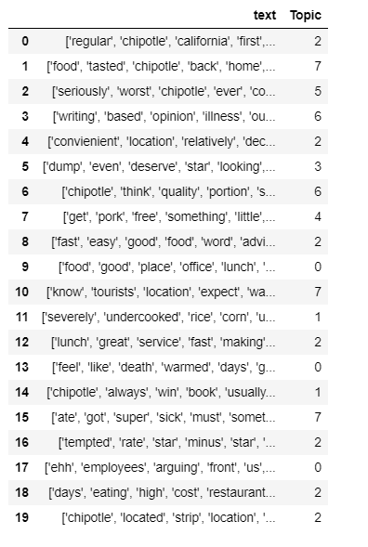
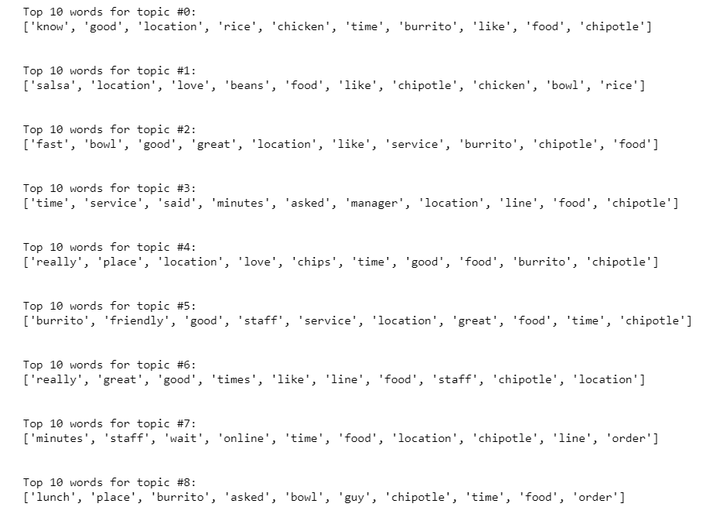
Visualisation of topics
Example restaurant: Chipotle Mexican Grill

Slide 8
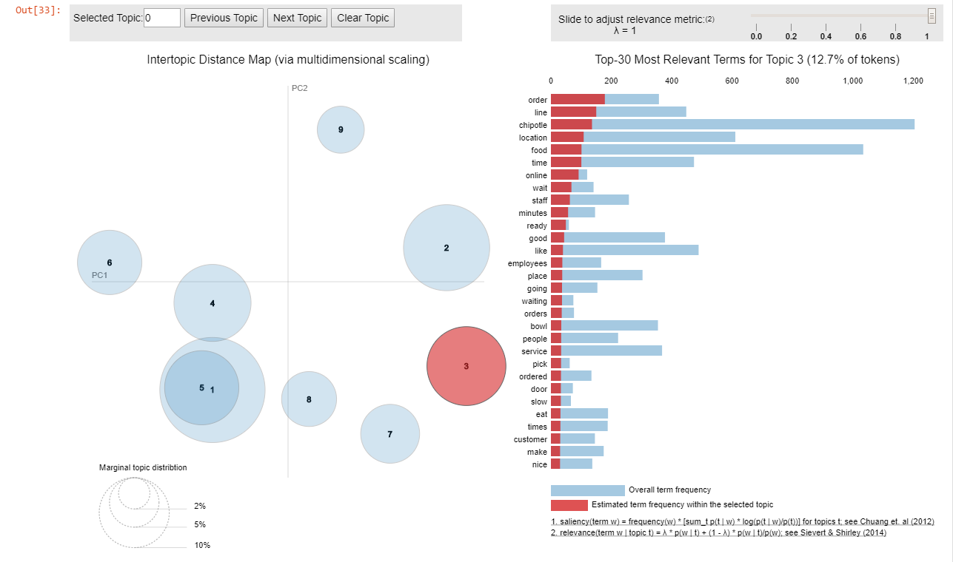
Visualisation of topics X continued

Slide 9
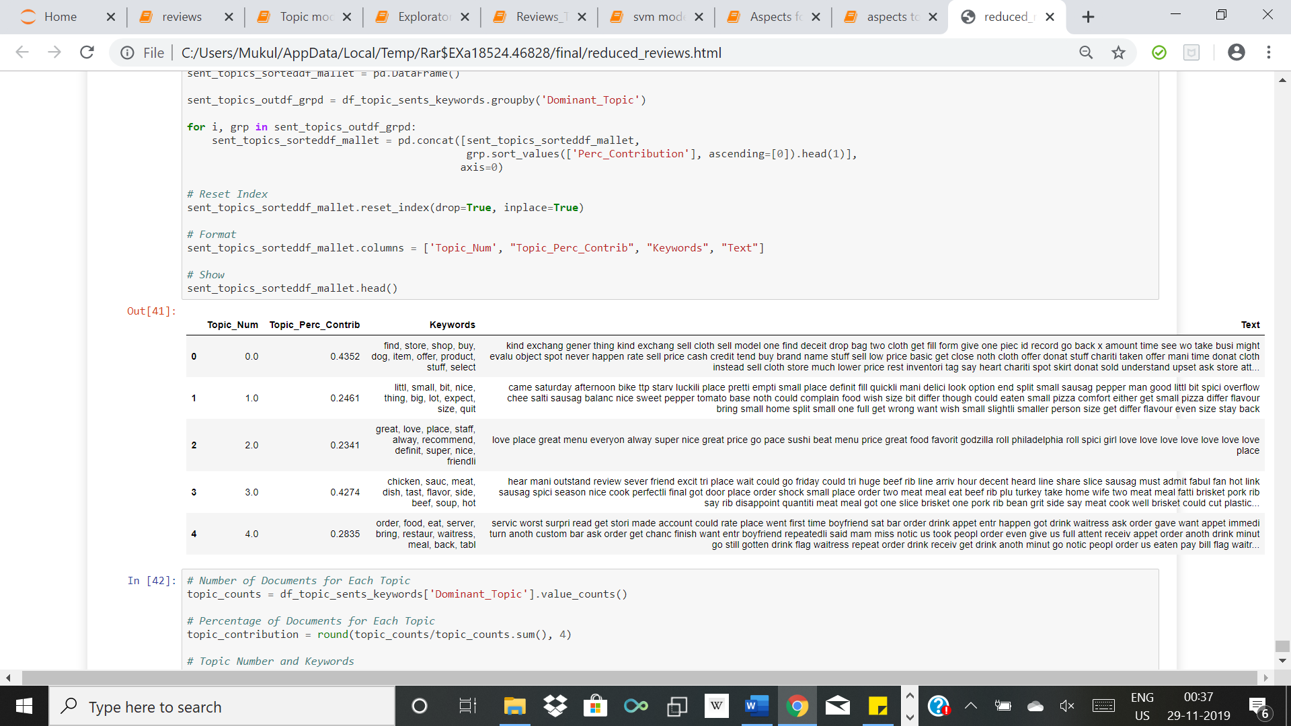
Topic Modelling on all the reviews

Slide 10
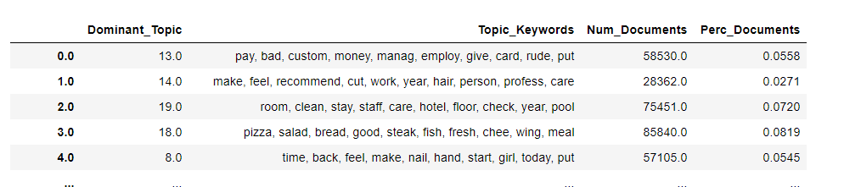
Topic Modelling on all the reviews

Slide 11
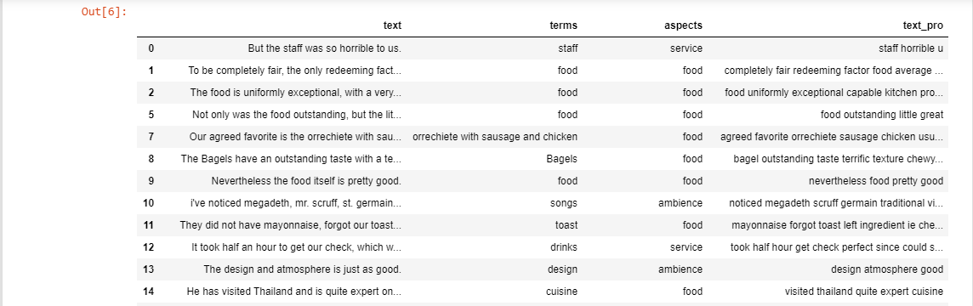
Aspect oriented Topic Modelling X Dataset
Used annotated restaurant reviews dataset as training set to get the aspects.
Focused on Ambience, Service, Food and Price as different aspects in the restaurant reviews

Slide 12
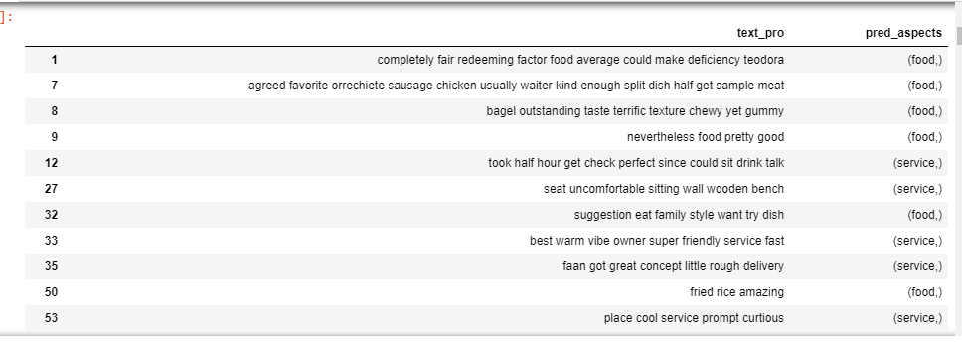
Aspect oriented Topic Modelling X SVM Model
Tried with various models to check which model gives the highest accuracy; OneVsRest, MLKNN, Classifier Chains, Label Powerset and SVM
SVM gave the highest accuracy of 88.22%

Slide 13
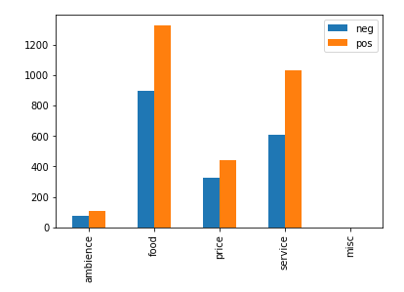
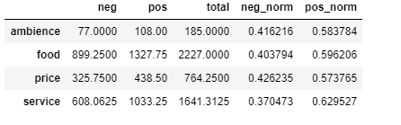
Aspect oriented Topic Modelling X Visualising the result
Example restaurant: Chipotle Mexican Grill

Slide 14
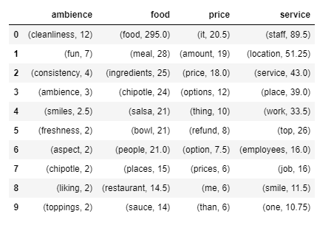
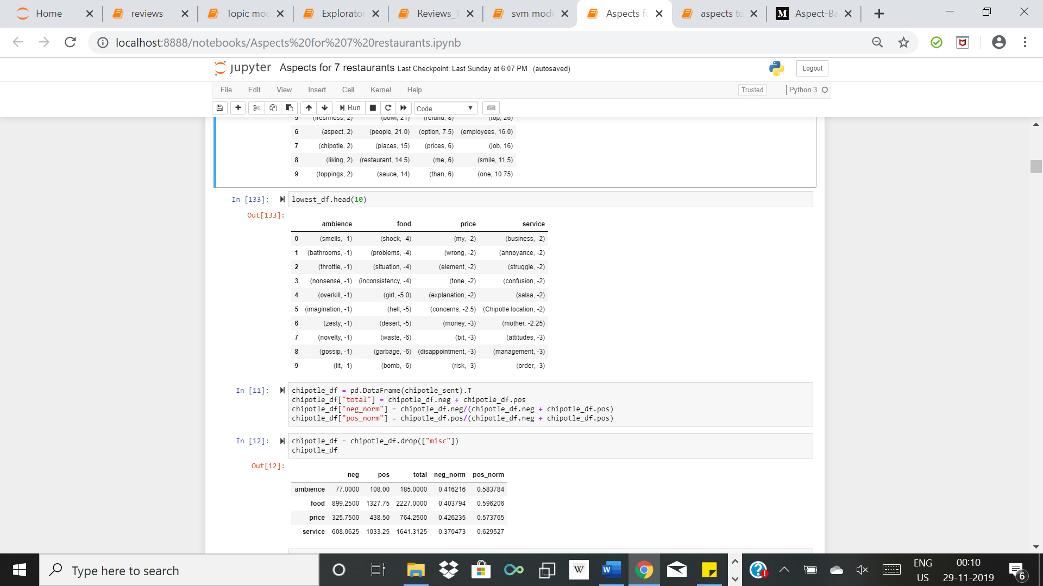
Aspect oriented Topic Modelling X Visualising the result

Slide 15
Aspect oriented Topic Modelling X Conclusion
Performed Topic Modelling using LDA on reviews of the restaurants and found the topic words that people are using the most by visualising the results
Extracted positive and negative sentiments for various restaurant businesses and divided them according to aspects of the restaurants. This can better help the restaurant business to identify the areas in which they can improve

Slide 16
Thank You!

